Slide 1




Cloud Native Applications
Workshop Kickoff

Slide 2

Welcome!

Slide 3
Logistics
Breaks
Lunch
‘The Facilities’
Email & Cellphone Etiquette
Questions

Slide 4
Speakers
Paul Hopper
Platform Architect, Pivotal (phopper@pivotal.io)
Chris Busch
Platform Architect, Pivotal (cbusch@pivotal.io)
Jenny McLaughlin
Platform Architect, Pivotal (jmclaughlin@pivotal.io)

Slide 5
Agenda
8:00 AM – 8:15 AM Introduction
8:15 AM – 8:45AM Cloud Native Introduction
Industry Trends and Overview including: 12 Factor Apps, DevOps, Microservices and Cloud Platforms
8:45AM – 9:15 AM Cloud Native Platform
An overview of Cloud Foundry (PCF) and its Architecture
9:15AM – 9:45 AM Services Made Easy
PCF Services (Database, Messaging, etc.) and the Marketplace
9:45 PM – 10:00 AM Break
10:00 PM – 11:45 PM Developer Workshop
Hands-on pushing code with PCF
11:45 PM - 12:00 PM Wrap Up, Q/A, & Feedback
Notes:
At 11:30 get setup to do the install

Slide 6
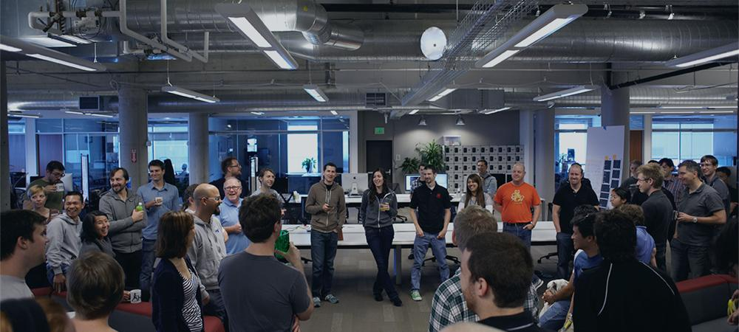
Introductions
Name, Team, Apps

